Slide 1

TURNKEY AFRICA LTD JIRA TRAINING DOCUMENTATION
Prepared by – Humphrey Mokaya & Corrine Achola
Presenter – Venessa Sila
27/09/2018

Slide 2
Training Outline
What is Jira?
The Jira Scheme
Creating an Issue in Jira:- Jira issue, issue types, issue priority, sub-tasks, workflows, use of clone and link in Jira
Features of a good Jira ticket
Jira Agile:- JIRA Scrum vs. JIRA Kanban
Reports in Jira
Creation and management of Dashboards in Jira
Jira portfolio

Slide 3
What is JIRA?
JIRA is a tool developed by Atlassian which is an Australian Company. It is used for;
bug tracking
issue tracking
Project management

Slide 4
JIRA Scheme
Inside JIRA scheme, everything can be configured, and it consists of;
Workflows
Issue Types
Custom Fields
Screens
Field Configuration
Notification
Permissions

Slide 5
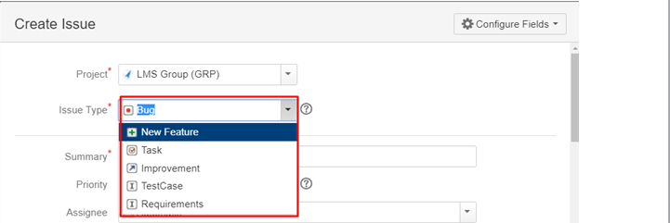
Creating an issue in Jira
What is a JIRA Issue?
JIRA issue would track bug or issue that underlies the project. Once you have imported a project then you can create issues. Projects include – LMS ordinary, LMS Group Life, FMS, GIS
Issue Types
Issue Type displays all types of items that can be created and tracked via JIRA. JIRA Issues are classified under various forms like new feature, sub-task, bug, etc. as shown in the screen shot.

Slide 6
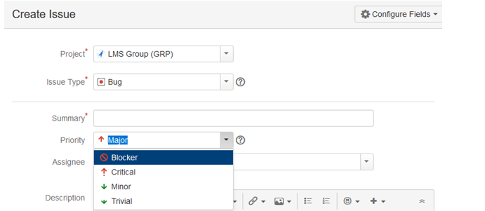
Issue priority
Can be classified as;
Blocker –Any issue blocking a user from proceeding with testing a project/deliverable.
Critical-Any issue classified as critical in a client’s SLA
Minor-Any issue that is not major as per the client’s SLA
Trivial-Issues classified as would haves e.g cosmetic issues

Slide 7
Creating an issue in Jira – Other fields
When creating an issue in Jira, all the mandatory fields are marked with a red asterisk.
Once the issue is created a pop-up will appear on your screen saying your issue is created successfully.
Now if you want to edit an issue or you want to export the issue to XML or Word document, then you can hover your mouse on main panel and click on Issues. Under Issues options click on search for issues that will open a window from where you can locate your issues and perform multiple functions.

Slide 8
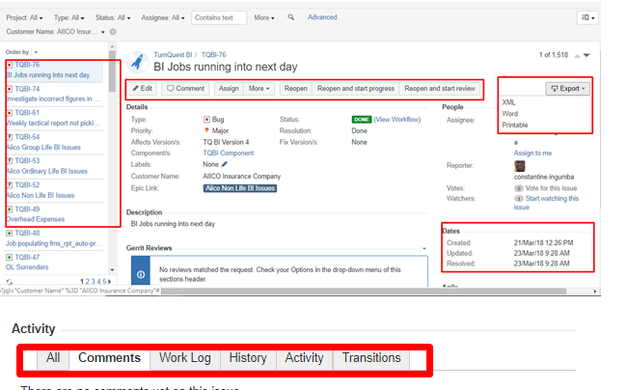
Creating an issue in Jira – Other fields
Search for issues option will bring you to a window where you can see the issues created by you like here we have issues TQBI-76 and TQBI-74
Here in the screen shot you can see the issue "BI jobs running into next day" and all the details related to it. From here, you can perform multiple tasks like you can reopen and start progress , reopen and start review, assigning issues and so on
Even you can export issue details to a XML or Word document.
Also, you can view activity going on the issue, reviews on the issue, work log, history of the issue and so on.
Under the time tracking option, you can even see the estimation time to resolve the issues

Slide 9
Sub-Task
Subtask issues are useful for splitting up a parent issue into a number of smaller tasks that can be assigned and tracked separately. It addresses issues more comprehensively and segregates the task into smaller chunks of task to do.
Sub-Task can be created in two ways
Create sub-task under parent issue
Creating an issue into a sub-task

Slide 10
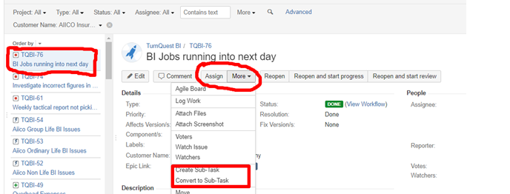
How to create a Sub-Task
To create sub-task in JIRA, you have to select an issue in which you want to assign the sub-task. Under the issue window, click on Assign more option, and then click on create sub-task as shown in the screenshot below. You can also select convert to sub-task under same tab to convert the parent issue into a sub-task.

Slide 11
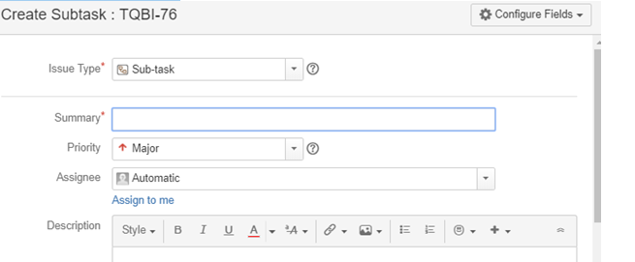
How to create a Sub-Task
Once you click on Create Sub-Task, a window will pop up to add sub-task issue. Fill in the details about the sub-task and click on Create as shown in below screen-shot, and this will create sub-task for the parent issue.

Slide 12
How to create a Sub-Task
Some important points to remember while creating Sub-Task
You can have as many sub-task as needed under an Issue
You cannot have a sub-task for a sub-task
Once a sub-task is created under a parent, parent cannot be converted into a sub-task
A sub-task can however be converted into a parent issue
You can work on your sub-task without having navigating away from the parent issue

Slide 13
WorkFlows
A JIRA workflow is a set of statuses and transitions that an issue goes through during its lifecycle. JIRA workflow encompasses the stages below once the issue is created.
Create Issue
Assign SME Issue
CS Testing
In development
Resolved Issue
Re-Opened Issue
Close Issue

Slide 14
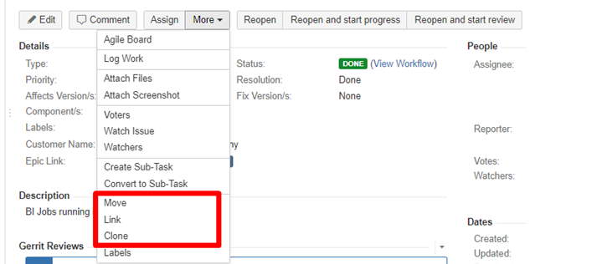
Use of Clone in JIRA
In JIRA, you can clone an issue – the main advantage of cloning an issue is that different teams can work separately on the issue and resolve the issue quicker.

Slide 15
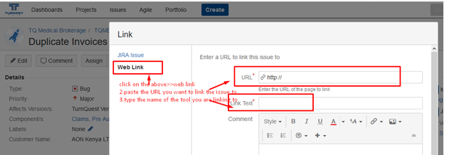
Use of Move and Link in JIRA
Move –enables you to tag an issue to the correct project if it had been captured under wrong project
Linking –enables you to link an issue to another tool used for reporting issues e.g Zendesk

Slide 16
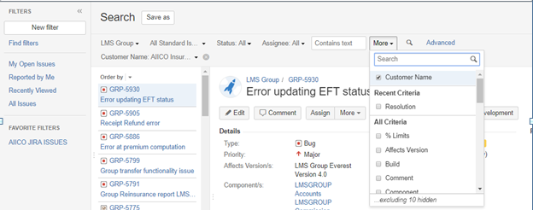
Filters
You can also set filters other than default filters to filter the issues. The filters that you can use are date, component, priority, resolution and so on.

Slide 17
Features of a good ticket
Short, precise and adequately descriptive subject of the ticket
Clearly outlines all the steps taken to arrive at the scenario
The description of the ticket to clear and exhaustive. This is to be done in such a way that the developer can read the description, understand it and work on it without having to sit with the BA whatsoever.
Gives the schema and link to the application where the scenario can be re-generated from
Error messages and scenario documentation to also be attached
The right priority date has to be entered to enhance planning and issue prioritization.

Slide 18
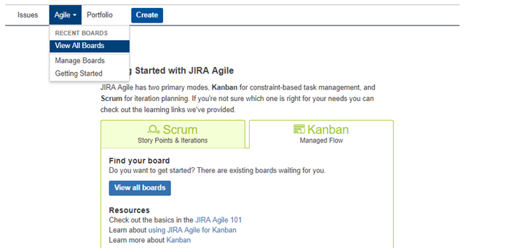
JIRA Agile
Agile or Scrum method is generally used by development teams who follows a roadmap of planned features for upcoming versions of their product.

Slide 19
JIRA Scrum vs. JIRA Kanban
Scrum | Kanban
Reports Burndown Chart: The chart shows all the changes and scope changed while the sprint is still on, other charts include Sprint Report, Velocity Chart, Epic Report, etc. | Reports Control Chart: It allows you to measure the cycle time for issues, showing the mean time and actual time taken to complete issues
Agile Board It allows the team to see the progress of sprints. This is the work mode, where you can see the board itself broken down into different statuses. | Constraints Team can decide whether to increase or decrease the number of issues that should be displayed in each status.
Backlog This is where team will plan sprints and estimate stories that will go into each sprint | Workflow You can map columns to the statuses of your workflow. Simply by adding or removing columns the workflow can be changed when required.

Slide 20
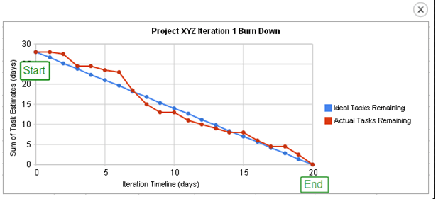
Reports in JIRA
To track the progress in Agile, a Burndown Chart shows the actual and estimated amount of work to be done in the sprint. A typical burndown chart will look somewhat like this, where the red line indicates the actual task remaining while the blue line indicates ideal task remaining during the scrum cycle.

Slide 21
Continued …Reports in JIRA
Apart from Burn down chart there are other options available in JIRA like Sprint Report, Epic Report, Version Report, Velocity Chart, Control Chart, Cumulative flow diagram. You can also use different chart option to represent the progress of your project.

Slide 22
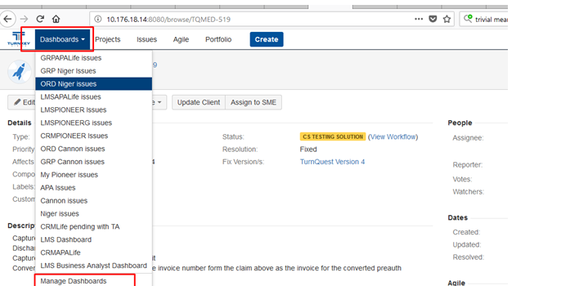
Creation and Management of Dashboards
New dashboards can be created by entering the name, description of the dashboard, start date and the favorites then click add.
Dashboards which is marked as favorites will be appearing when the dashboards tab is selected. Click on Dashboards as highlighted below>>then manage dashboards

Slide 23
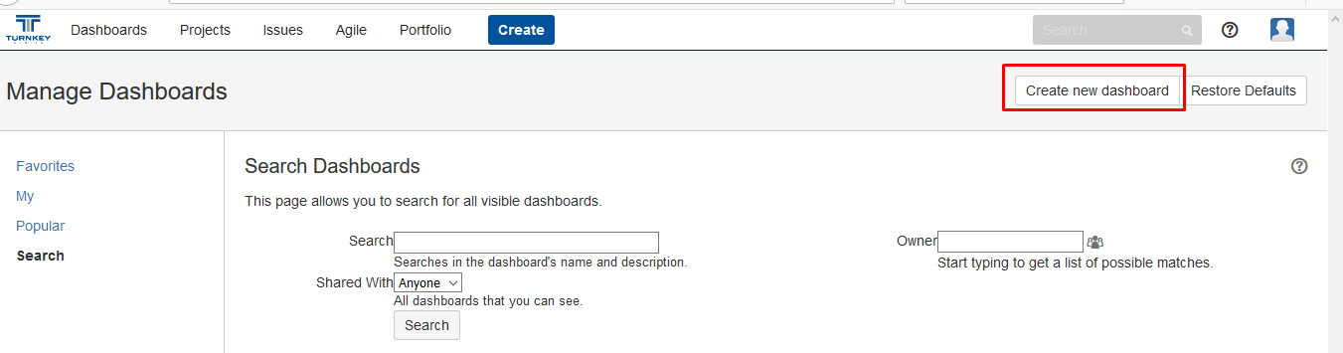
Creation and Management of Dashboards
Then click on the ‘create dashboard’ link on your far right which is highlighted in the screenshot below

Slide 24
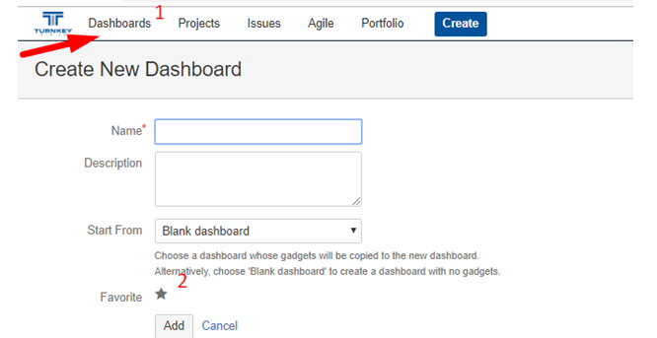
Creation and Management of Dashboards
Fill in the below fields and click on add.

Slide 25
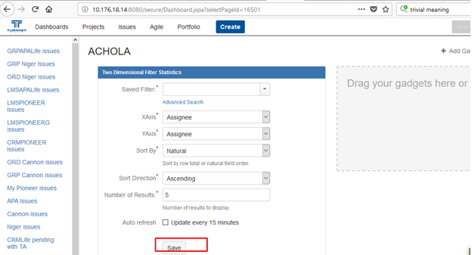
Creation and Management of Dashboards
The below screen opens. Click on my as highlighted for you to view the particular gadget created.
fill in the bellow fields an save .Filter name can be an existing filter created by someone else or a new filter created by you specifically for your projects.

Slide 26
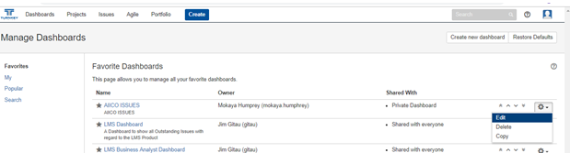
Creation and Management of Dashboards
Under dashboard management, all those tagged as favorites will appear as illustrated below.
A dashboard can be edited, deleted or copied. It can also be private or shared with everyone.

Slide 27
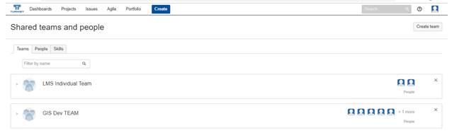
Portfolio
Enables the user to add;
Teams - e.g LMS Individual, GIS development team etc.
People – individual Jira users
Skills – Business analysis, development, project management etc.

Slide 28
END OF PRESENTATION
THANK YOU FOR YOUR ATTENTION
Q & A

